Slide 1
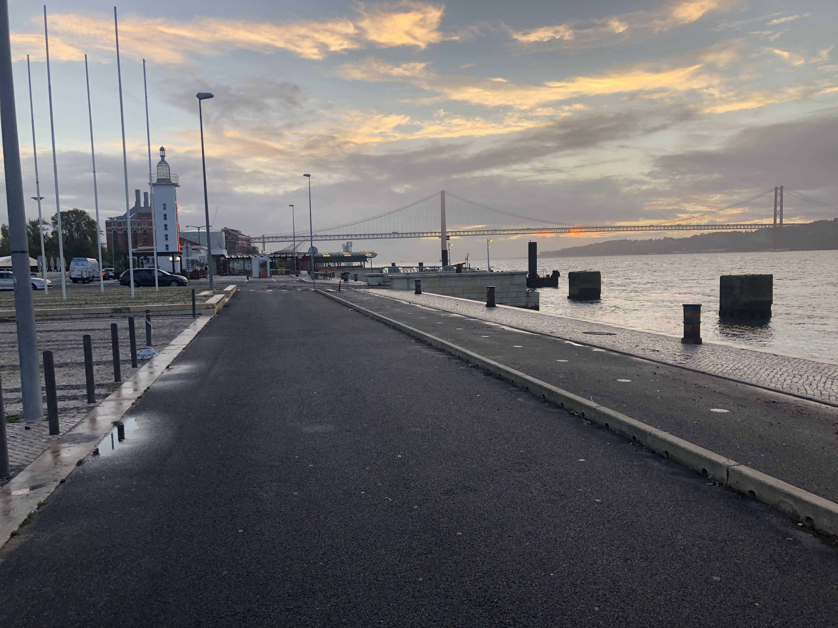
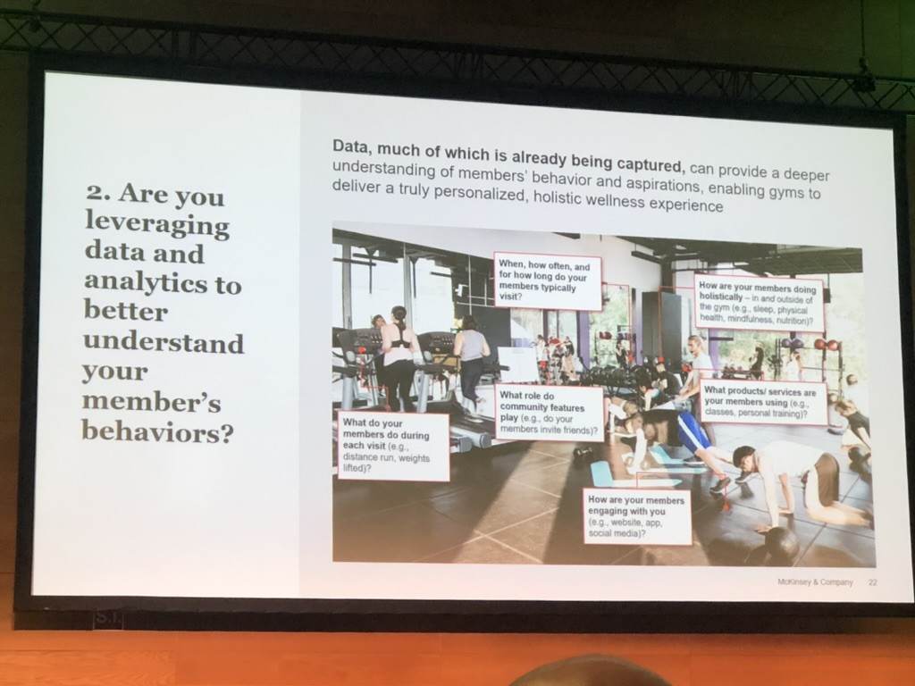
IHRSA European Congress 2023 Lisbon, Portugal: A brief summary
Hans Muench, Switzerland (www.hans-muench.com)

Slide 2
First European Congress since 2019
Smart Summit was held parallel to the ISPO event in Munich 2021
Lisbon has hosted the Congress before
Despite many events on the calendar, 350 attendees and over 20 sponsors came together
High level presentations from Microsoft, McKinsey, KPMG as well as industry speakers (Juan del Rey, Alan Leach, Sander van der Born, panel of European leaders from Norway to Portugal, and sales maestro from Ireland, Alan Leach)
Early morning exercise (harbour run/walk, gym, outdoor)
Networking receptions and lunches around the sponsor showcase

Slide 3
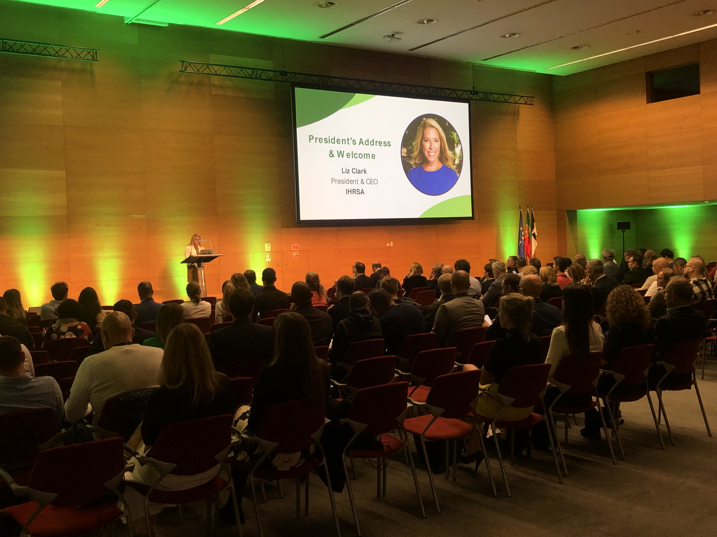
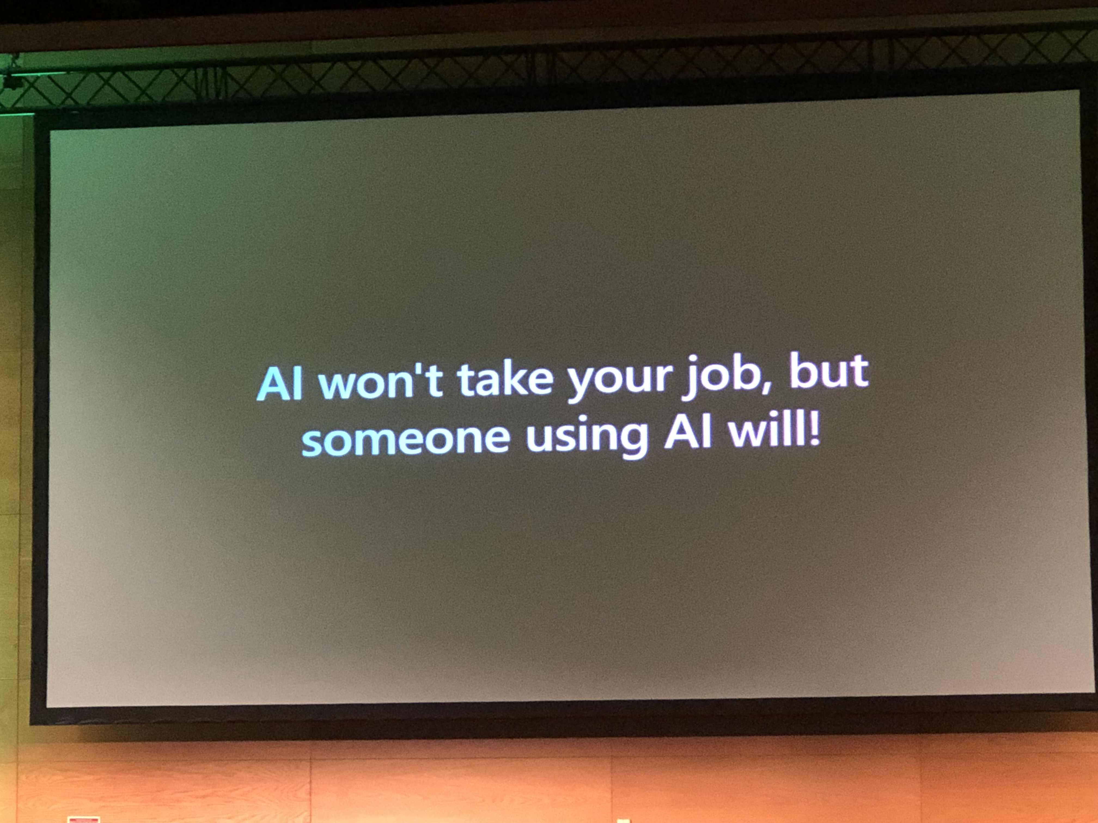
Opening day sessions: Intro IHRSA President Liz Clark / Generative AI: The Potential of ChatGPT in Sports

Slide 4

Portugal Activo Initiatives – Ana Damaso

Slide 5
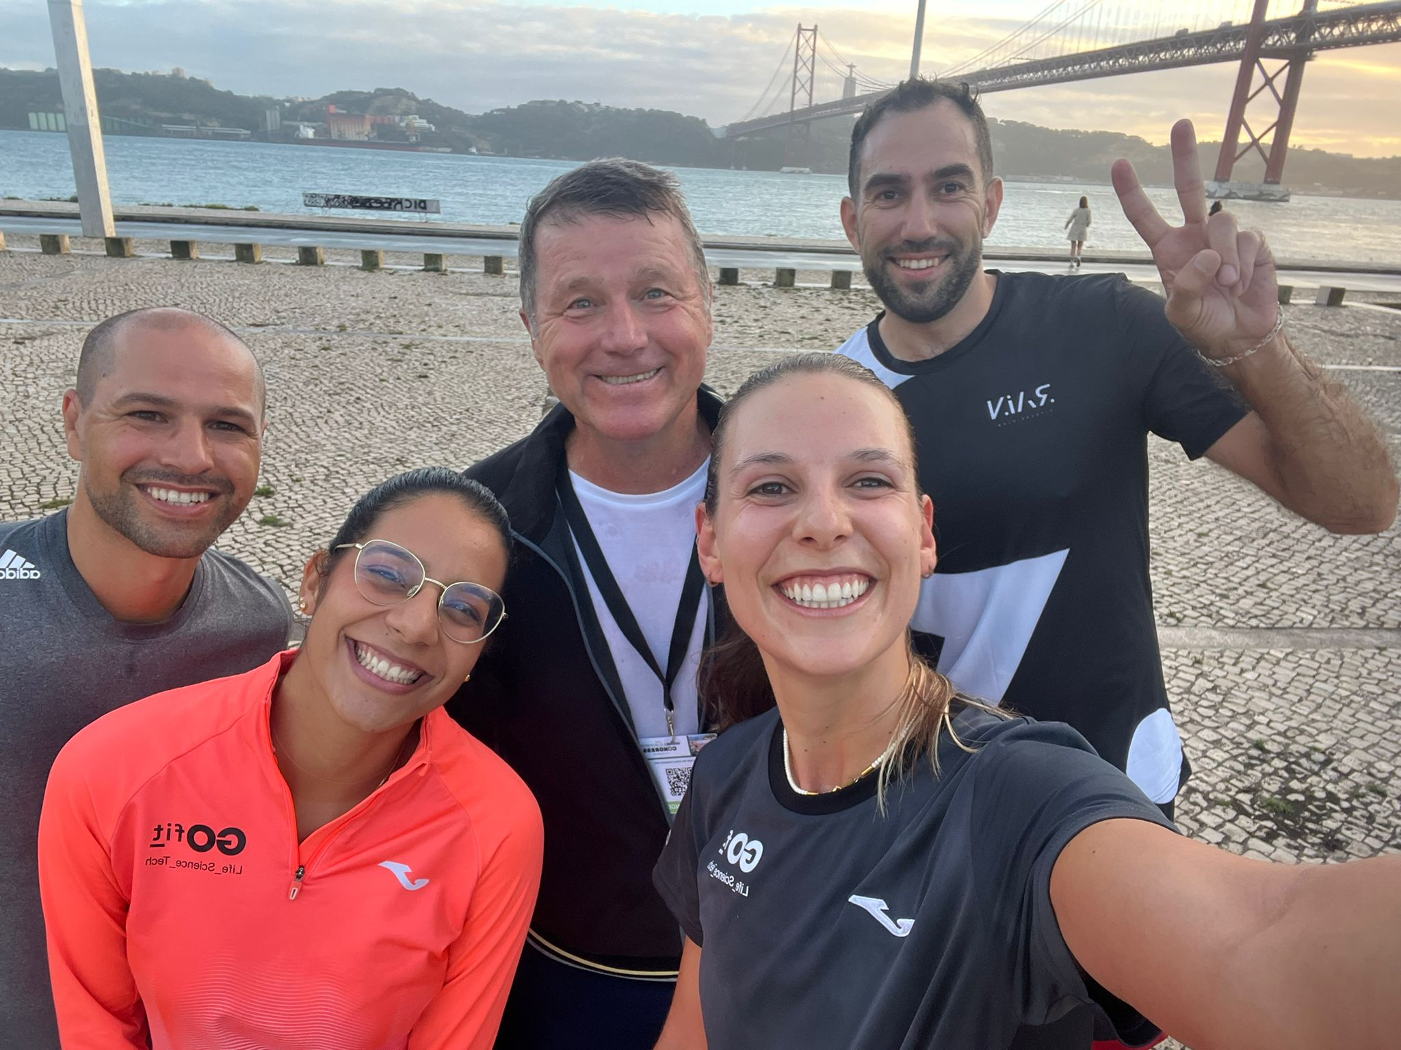
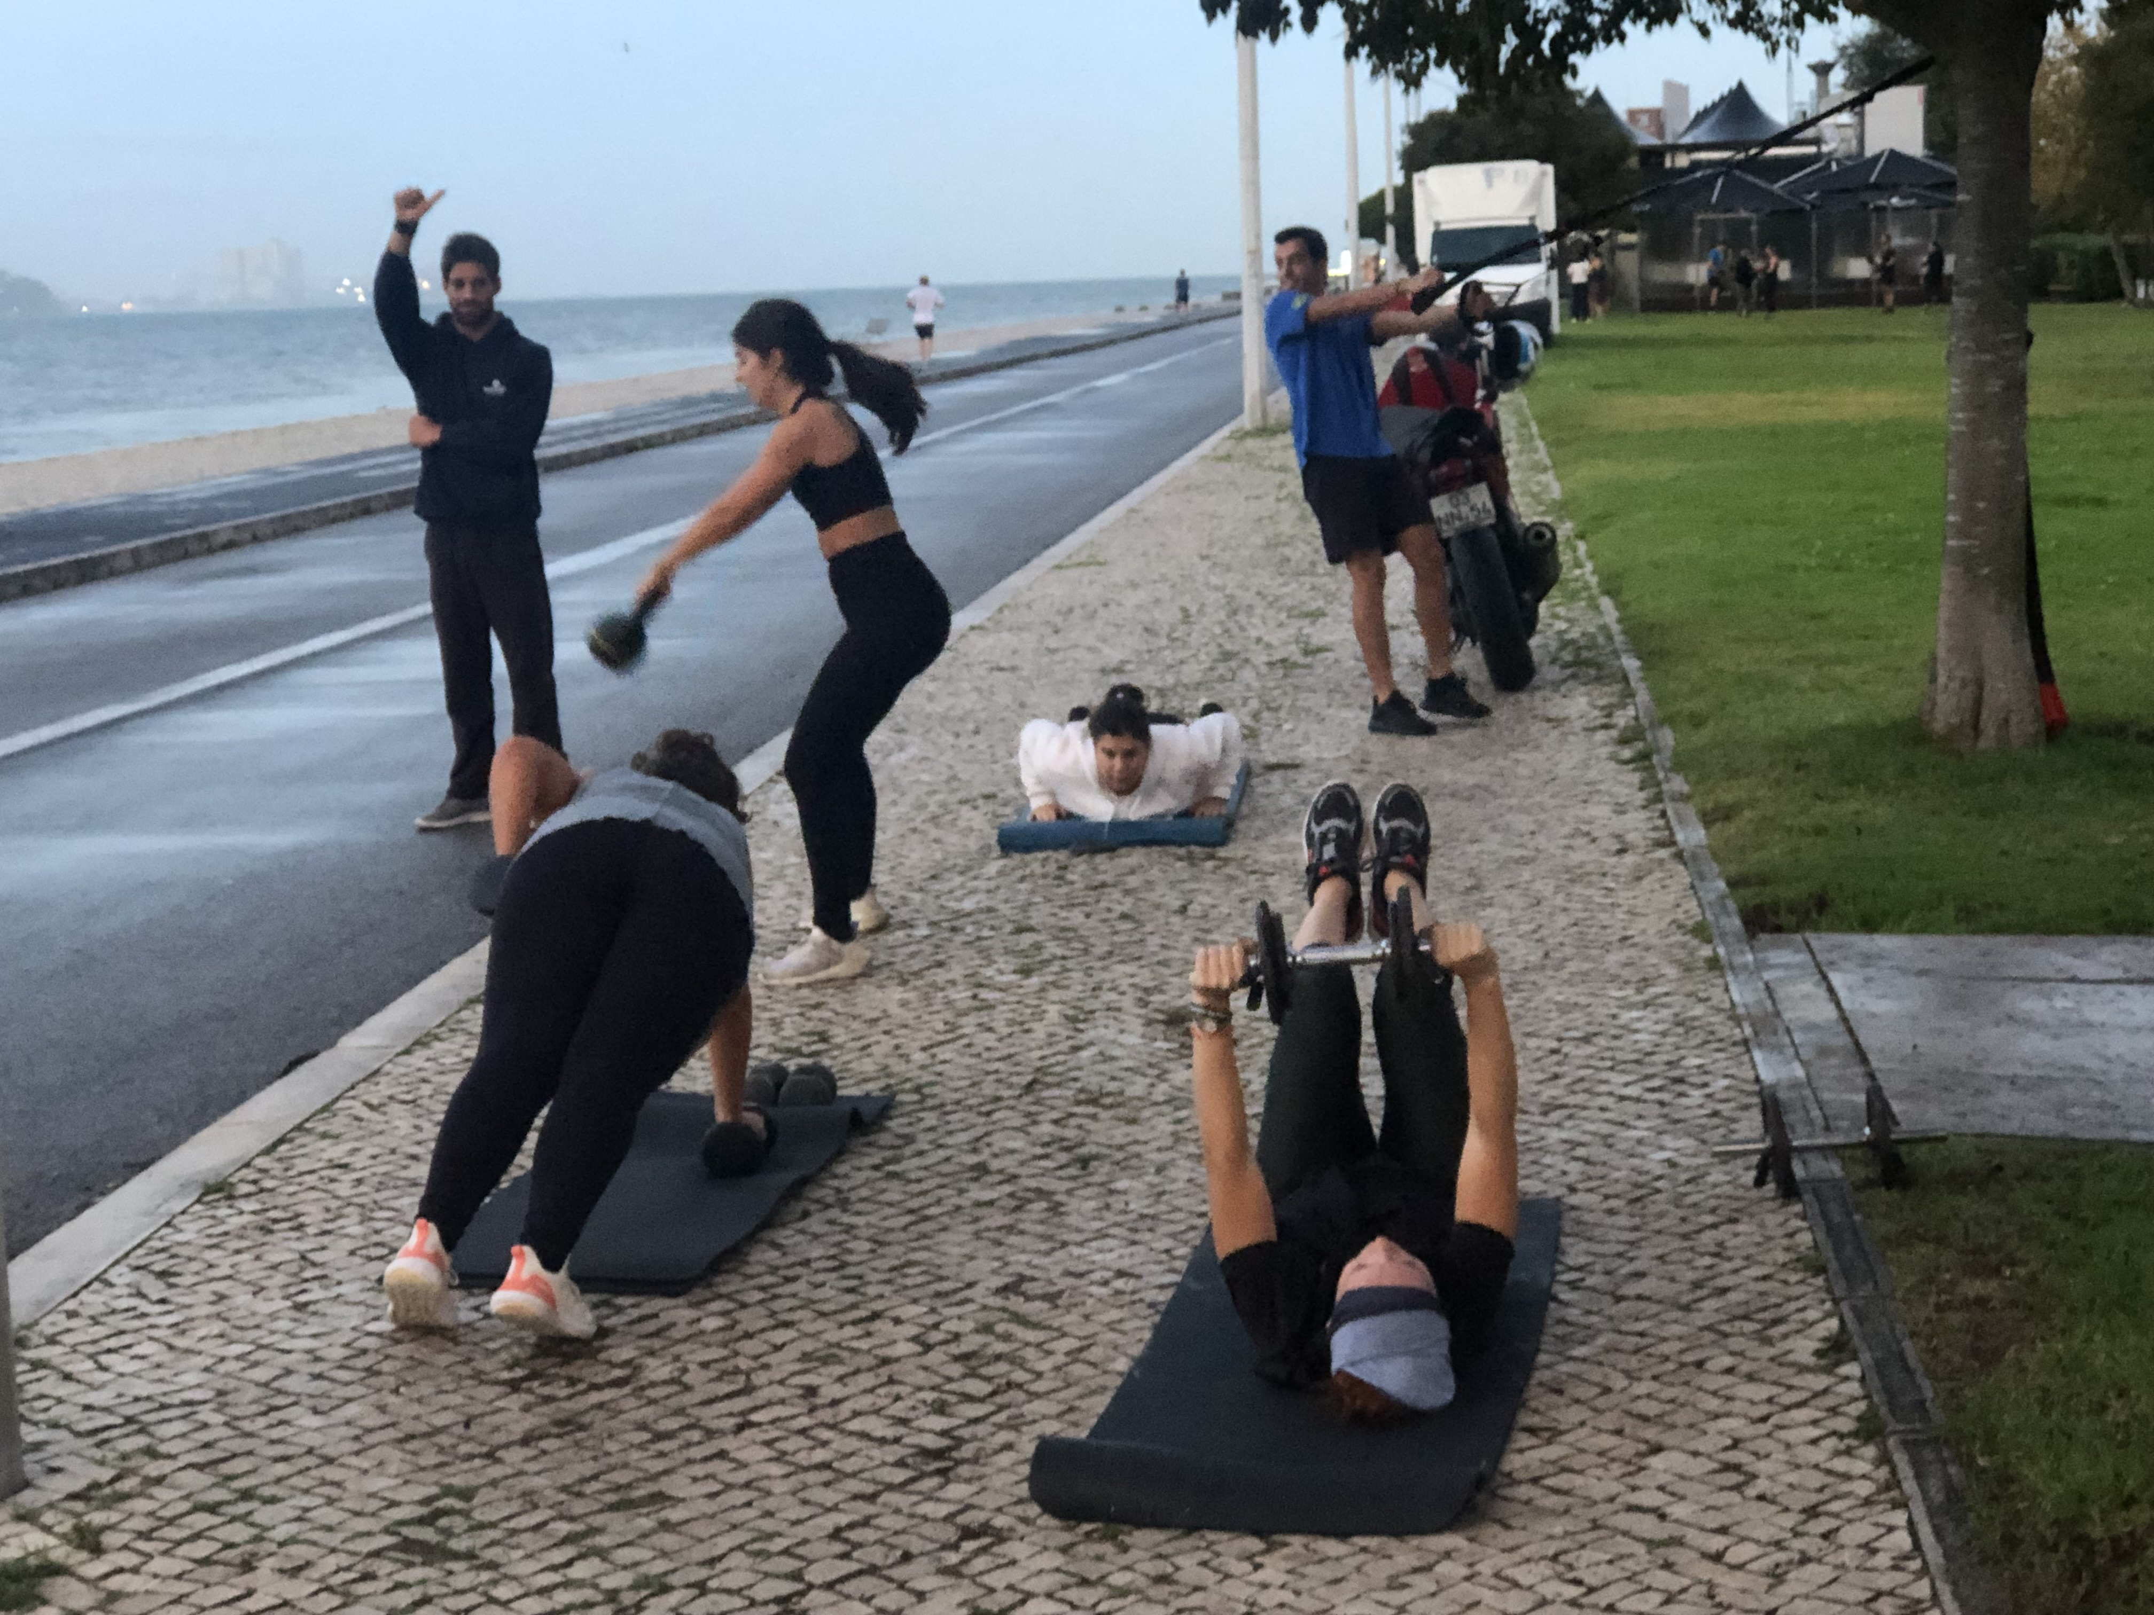
Wednesday 18.10.23: Early morning workout

Slide 6
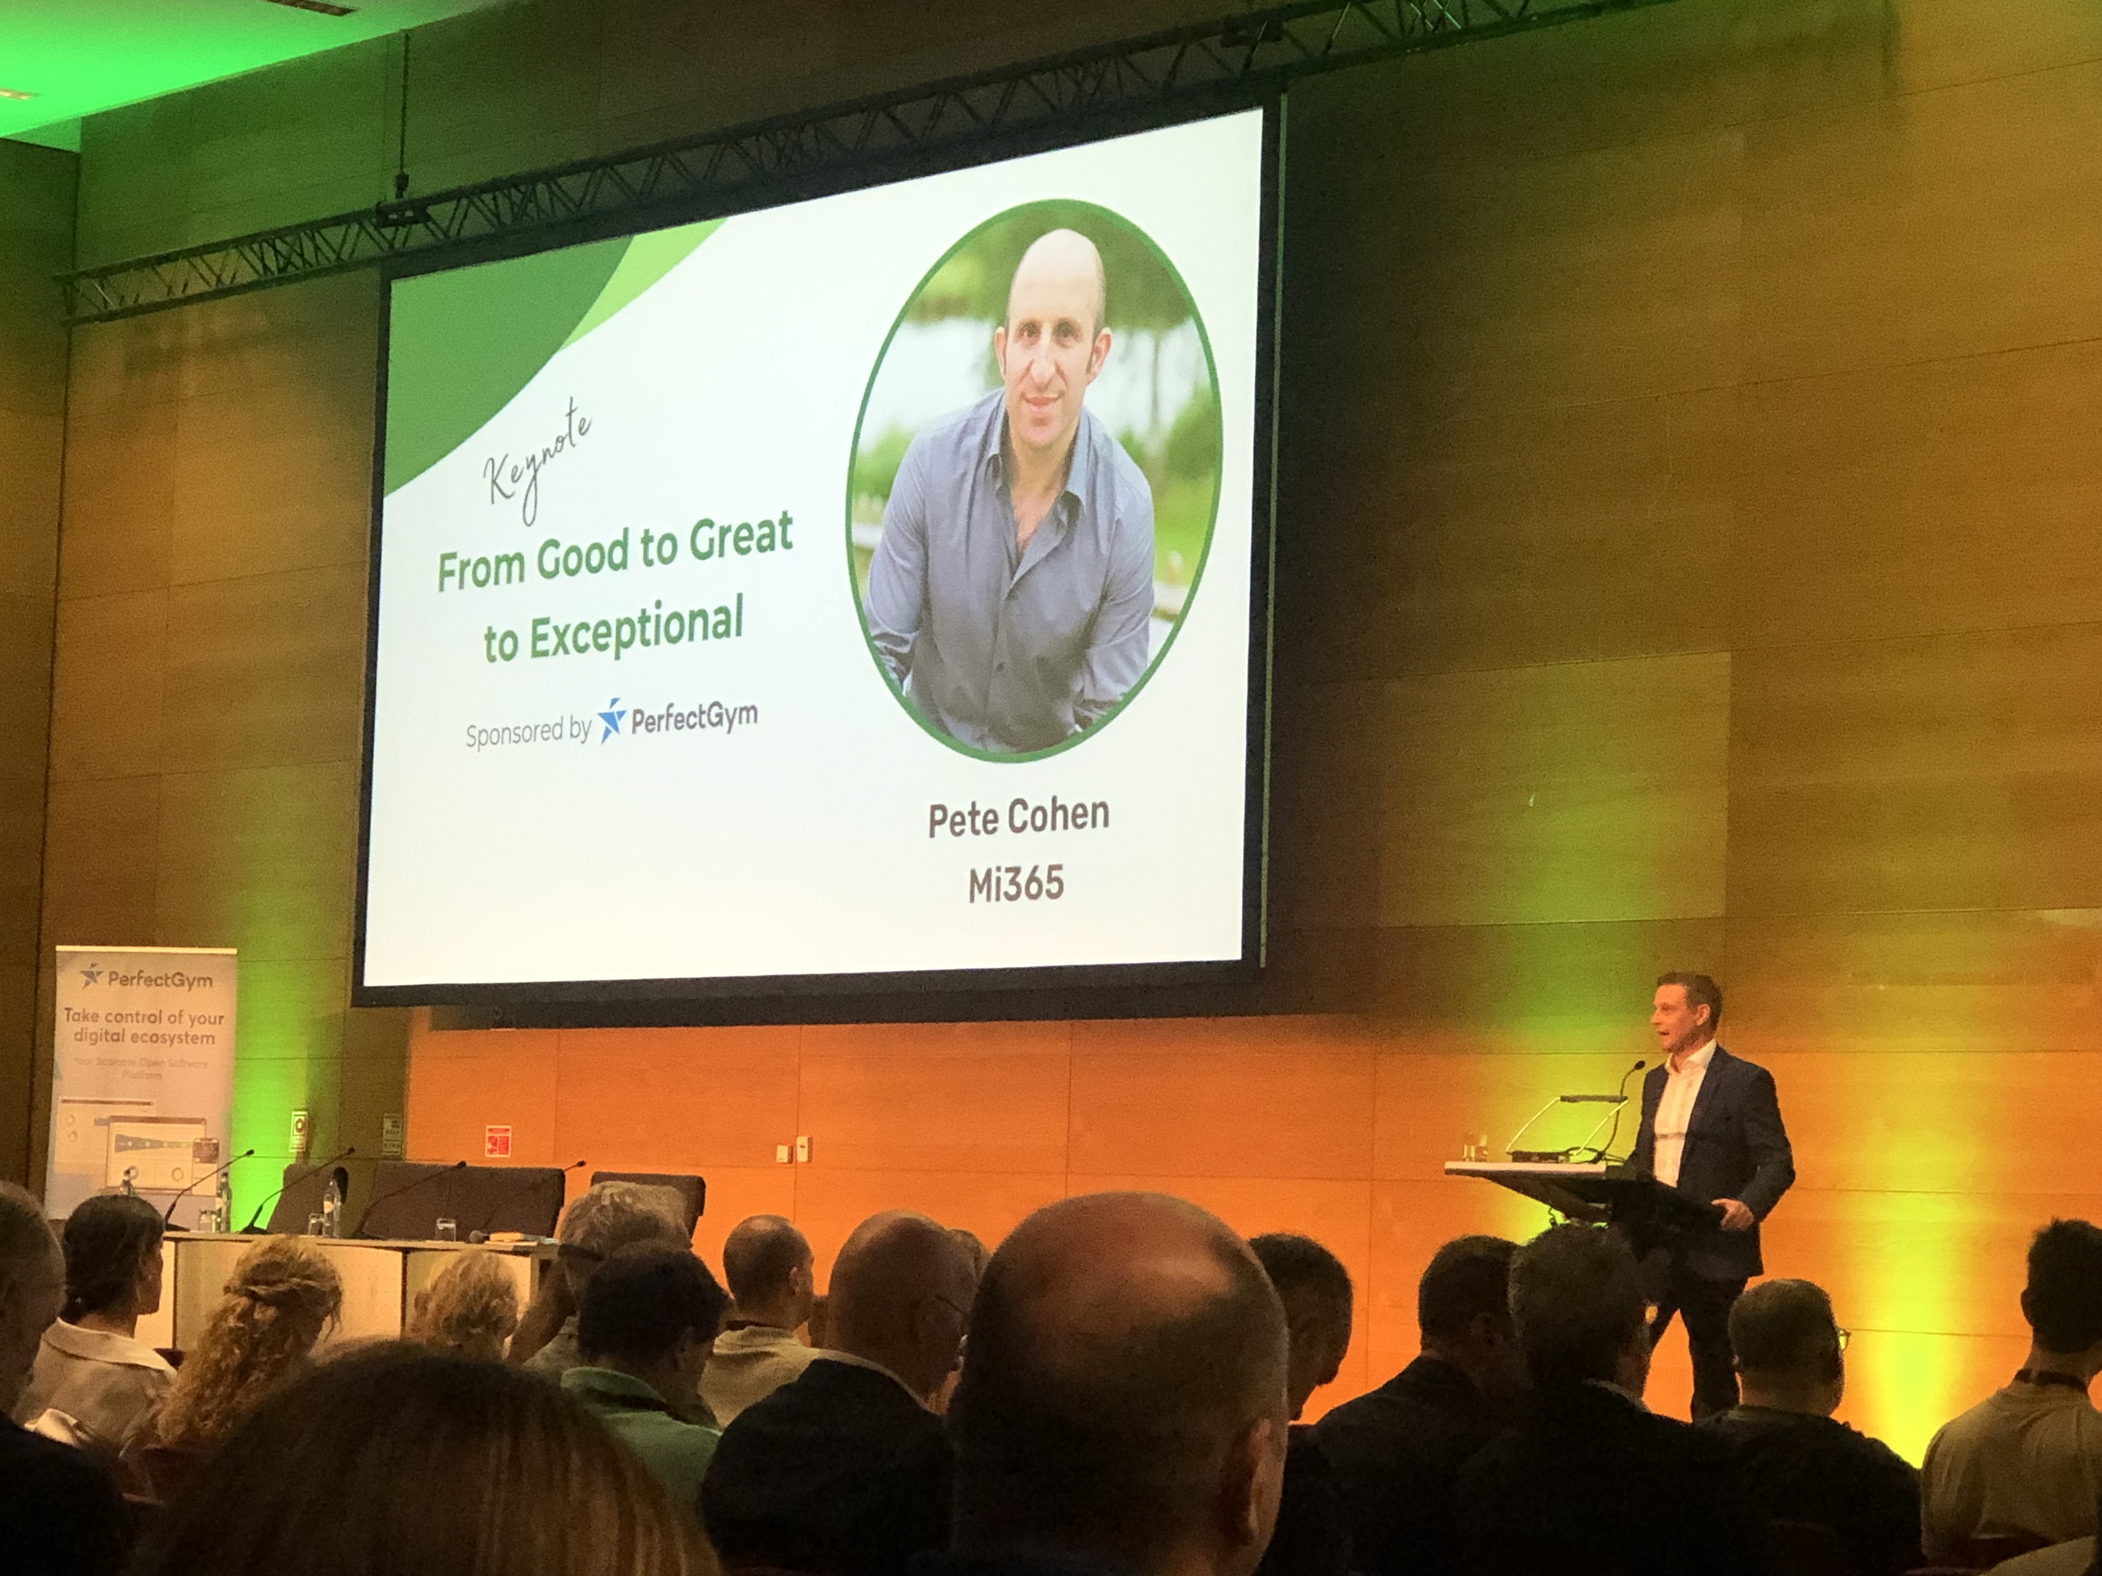
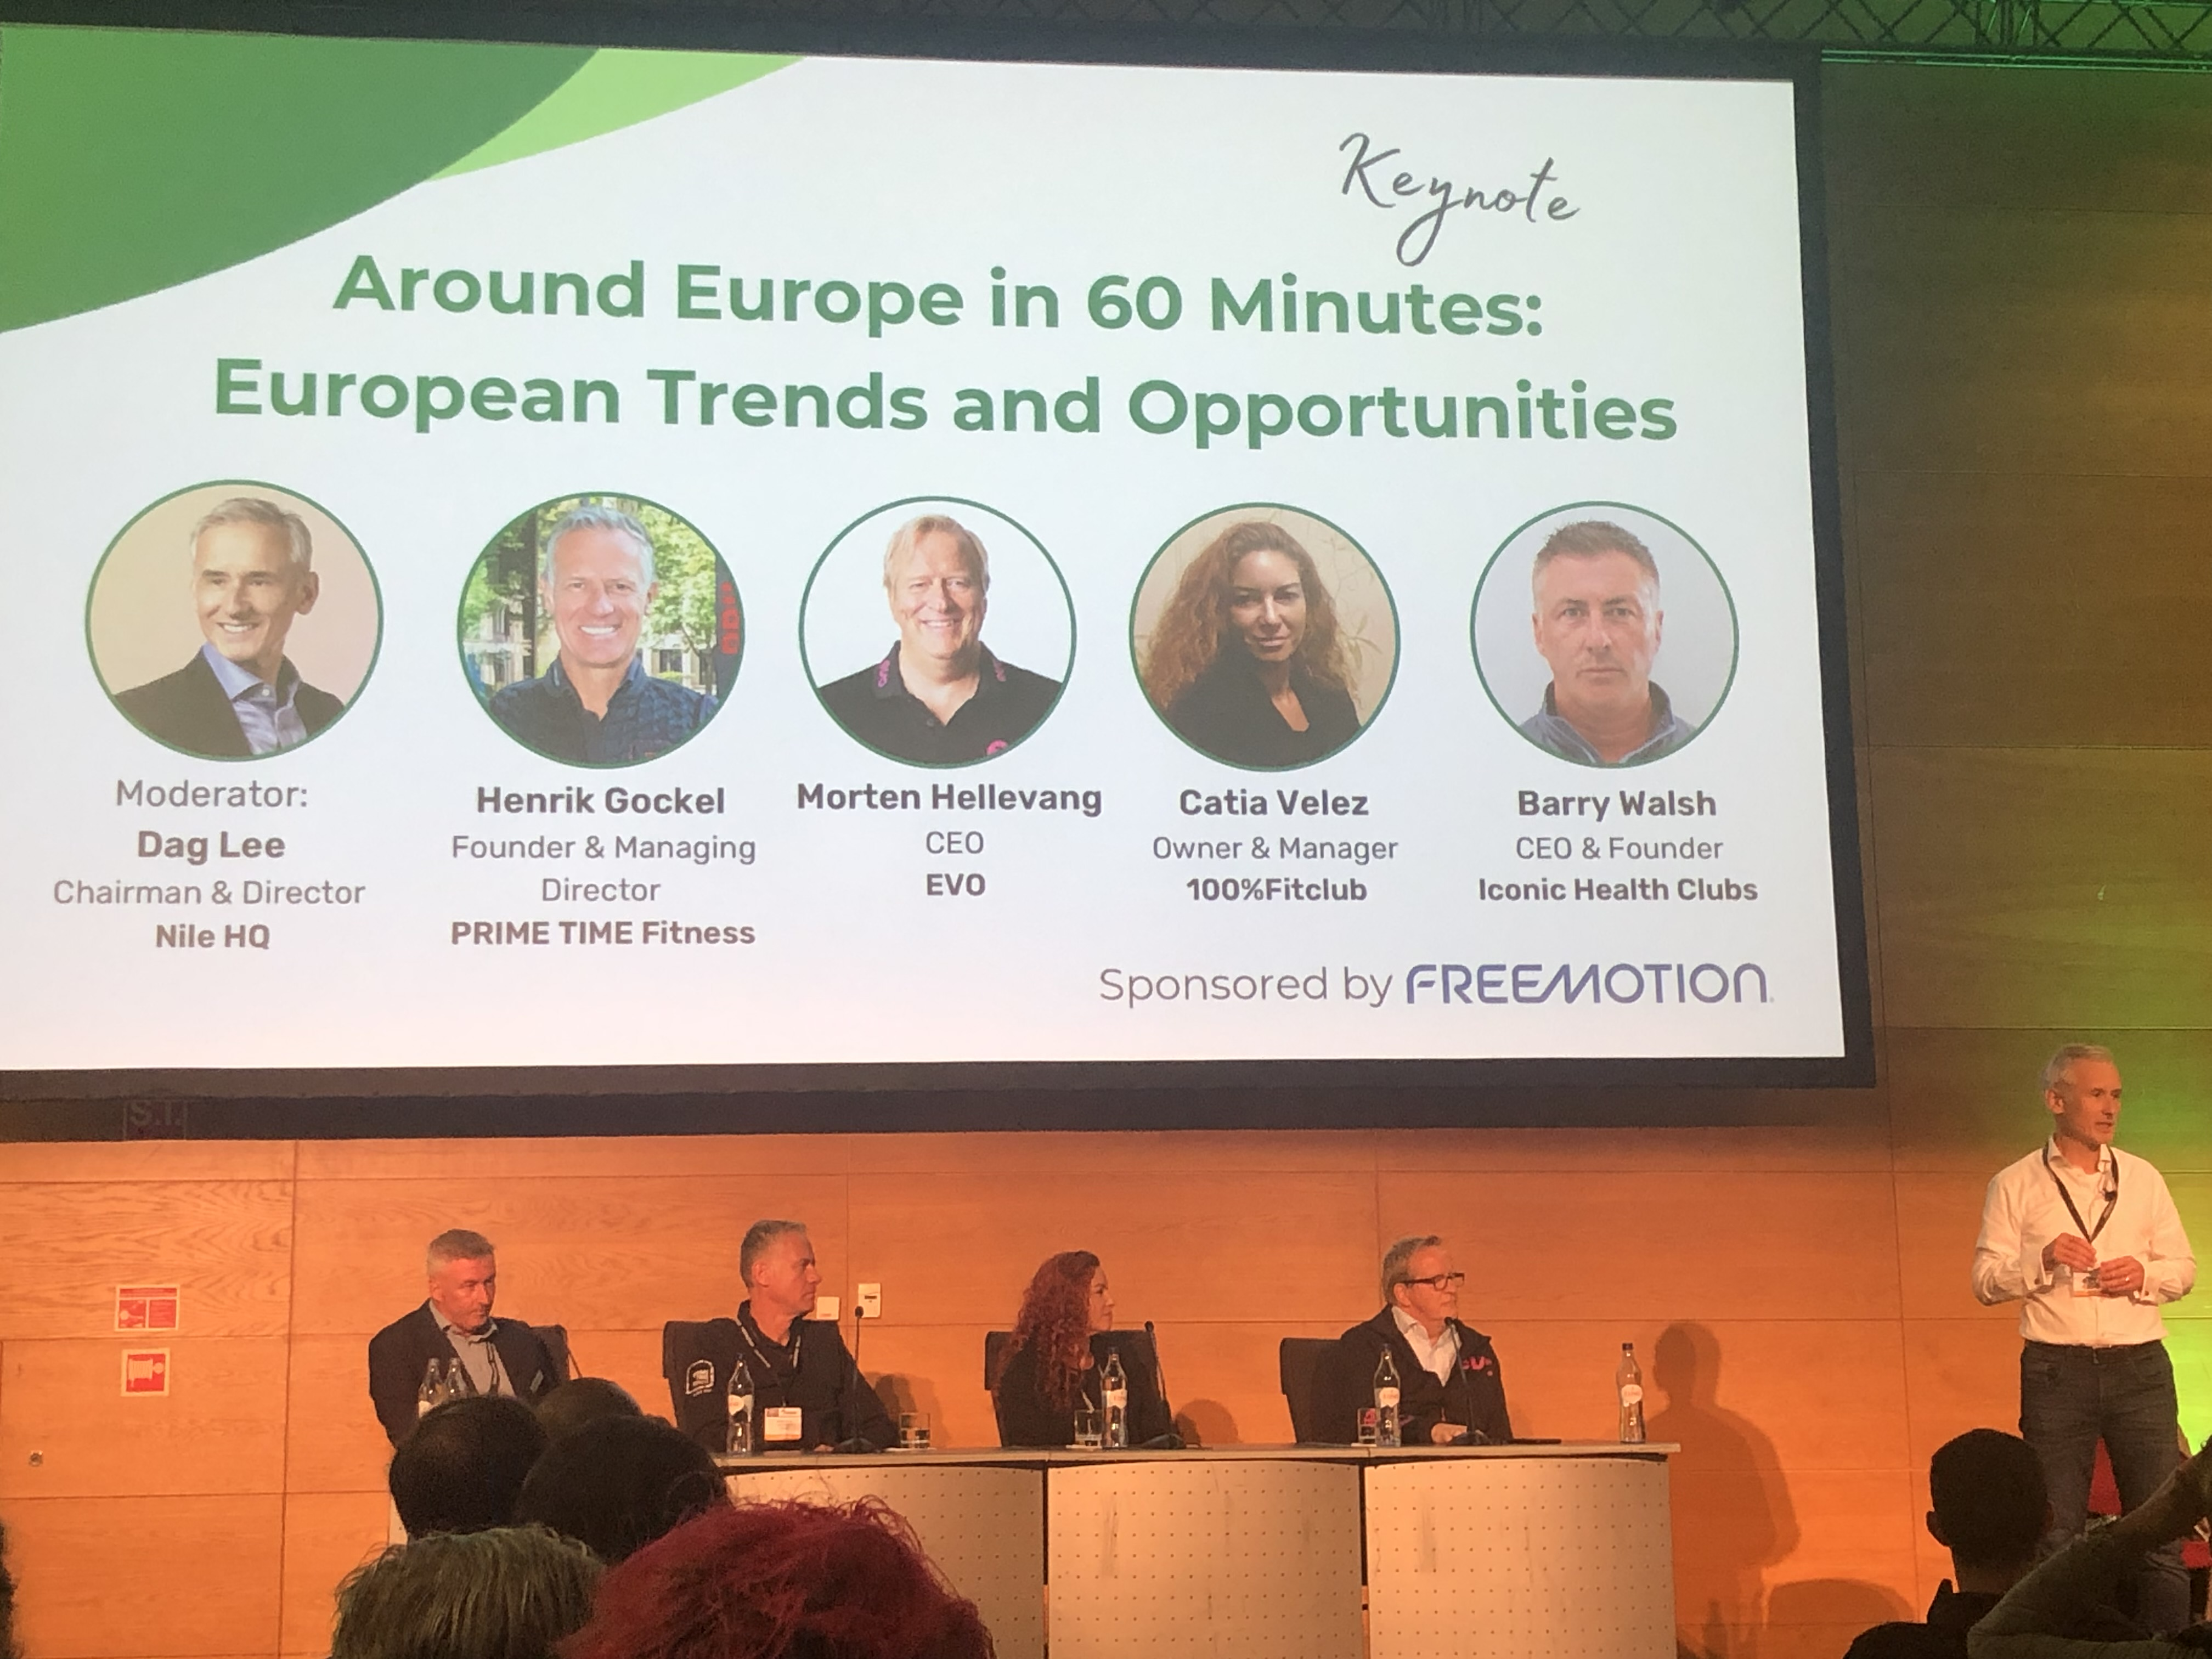
From Good to Great – Pete Cohan / Around the Europe in 60 minutes panel discussion

Slide 7
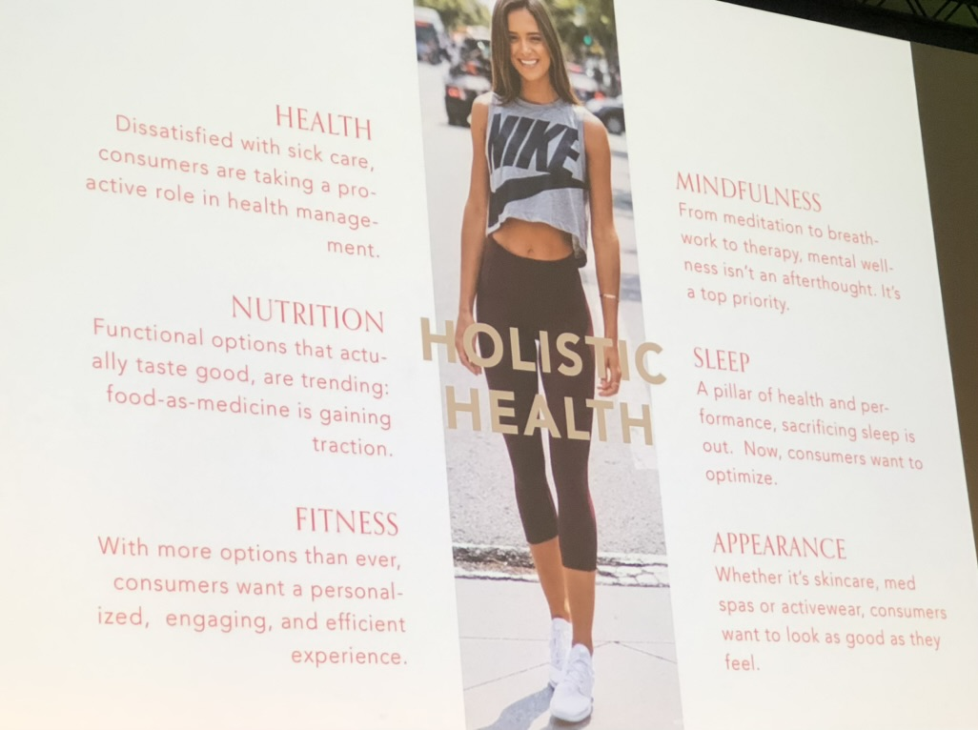
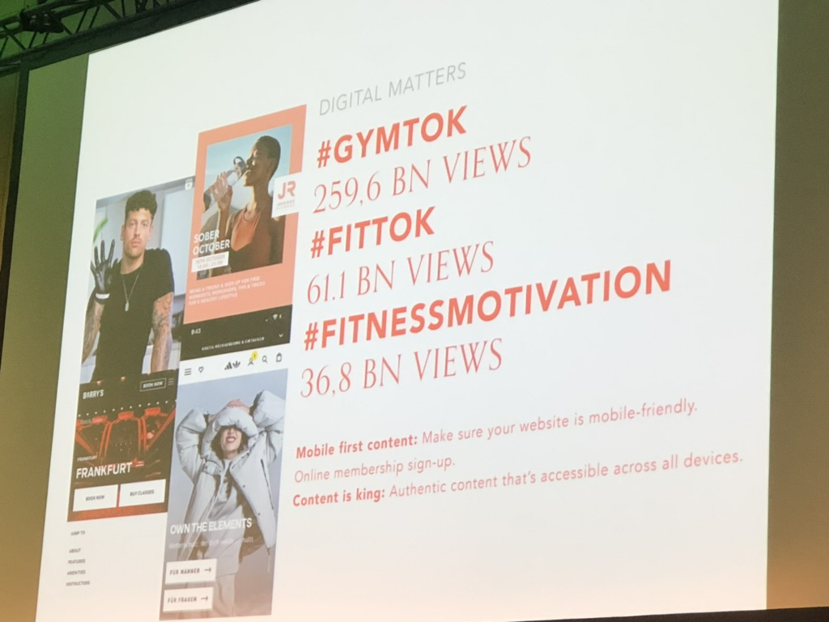
GenZ & Millenials – Silke Hensel, RSC

Slide 8
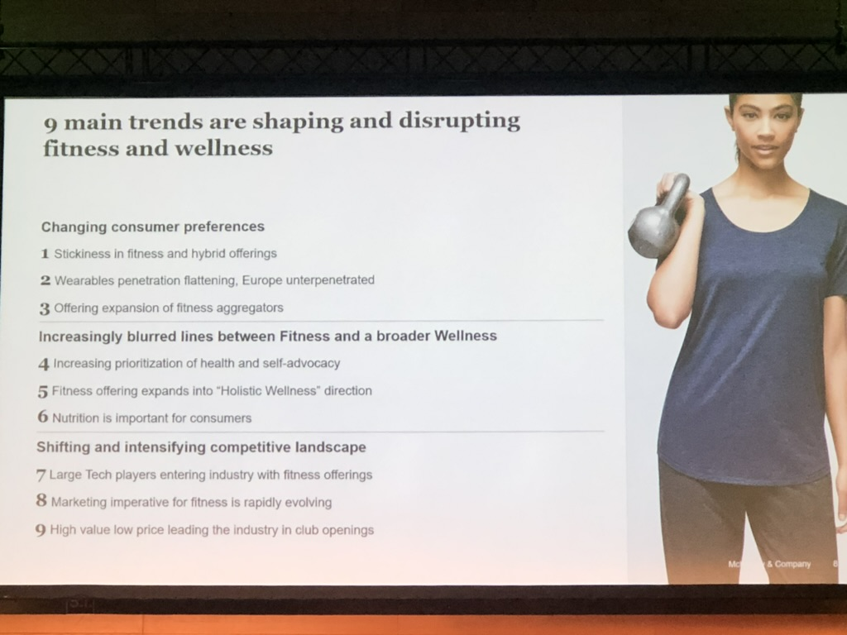
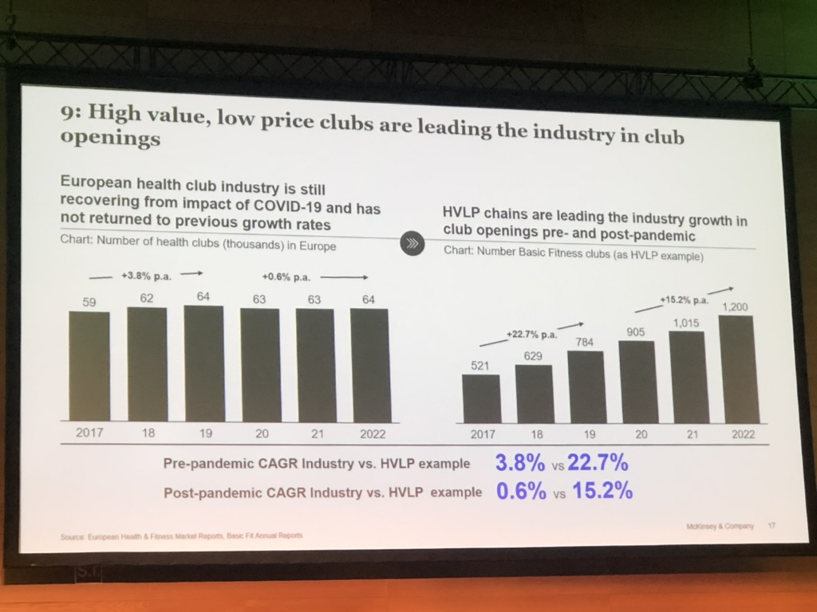
McKinsey Session: Game-changing Trends

Slide 9
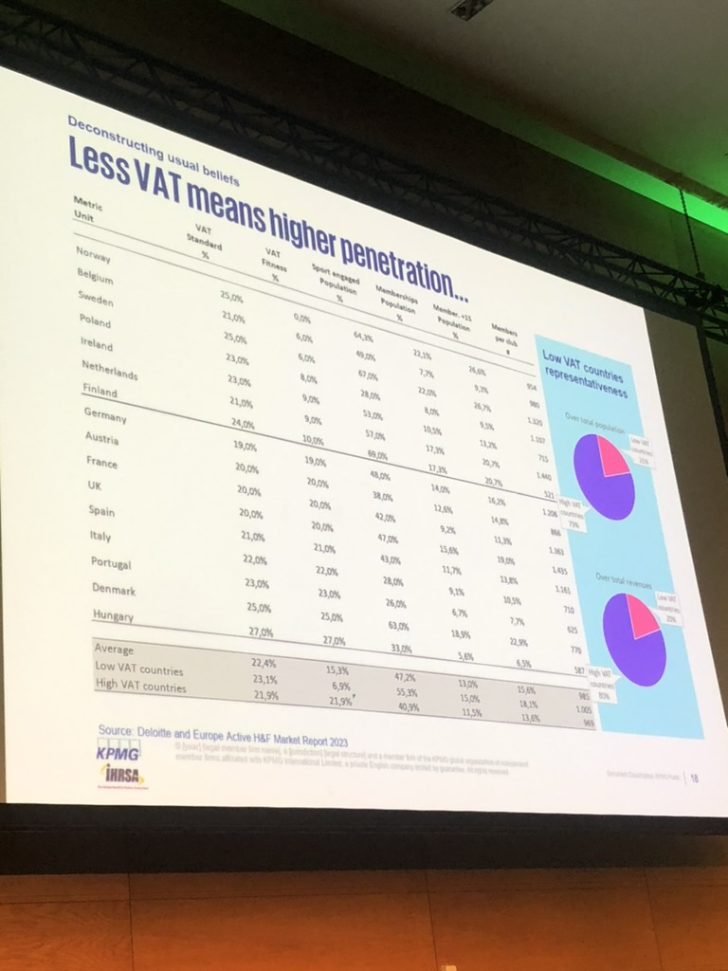
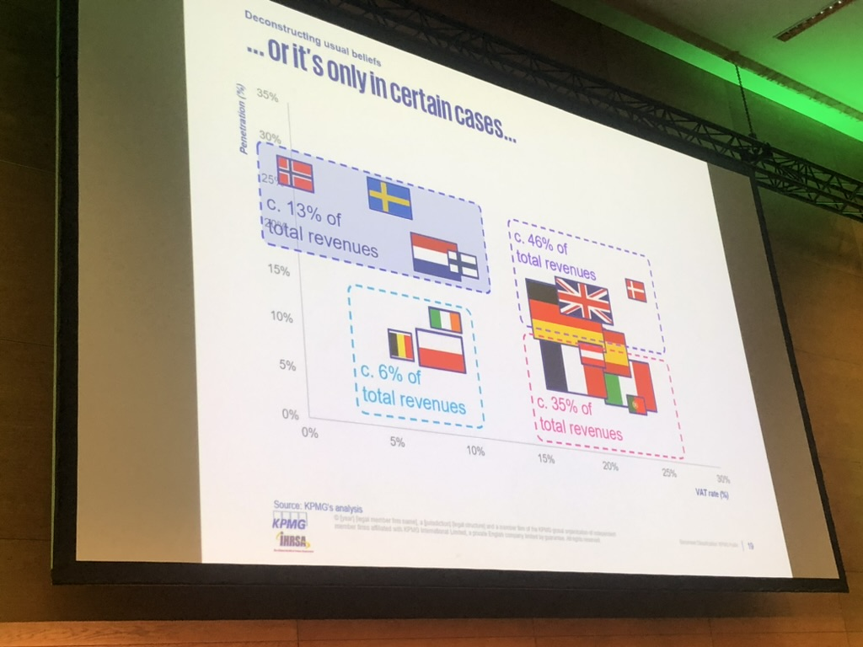
VAT: (is reducing) a game changer for the sector?

Slide 10
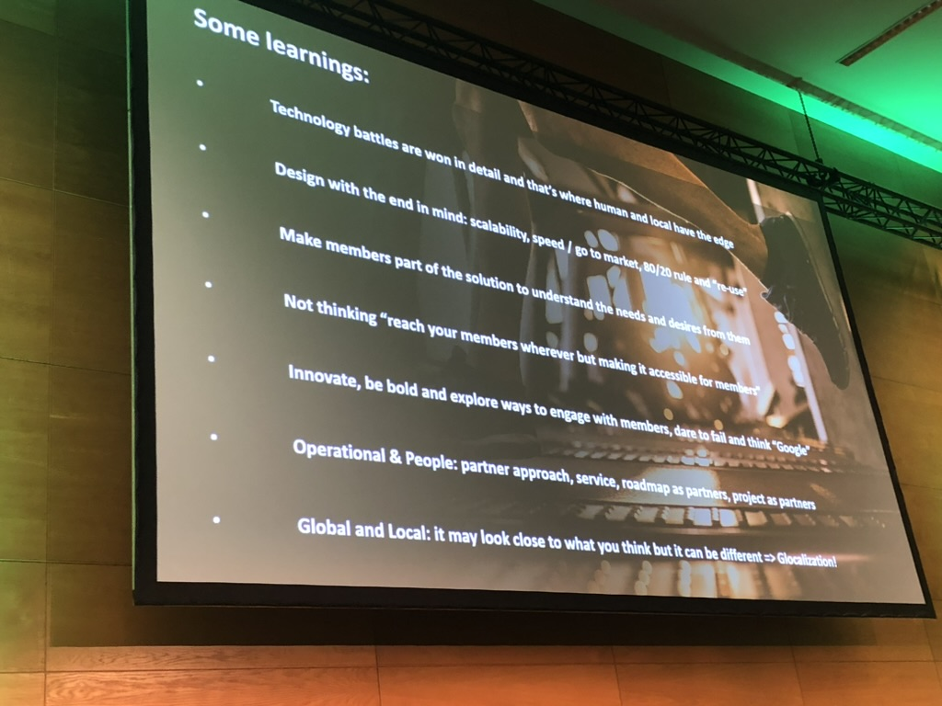
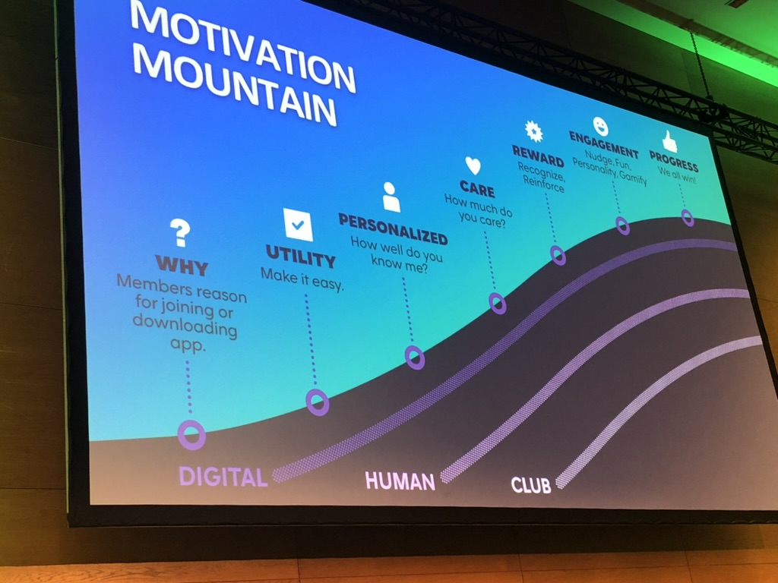
Fitness Technology Landscape – Sander van der Born

Slide 11
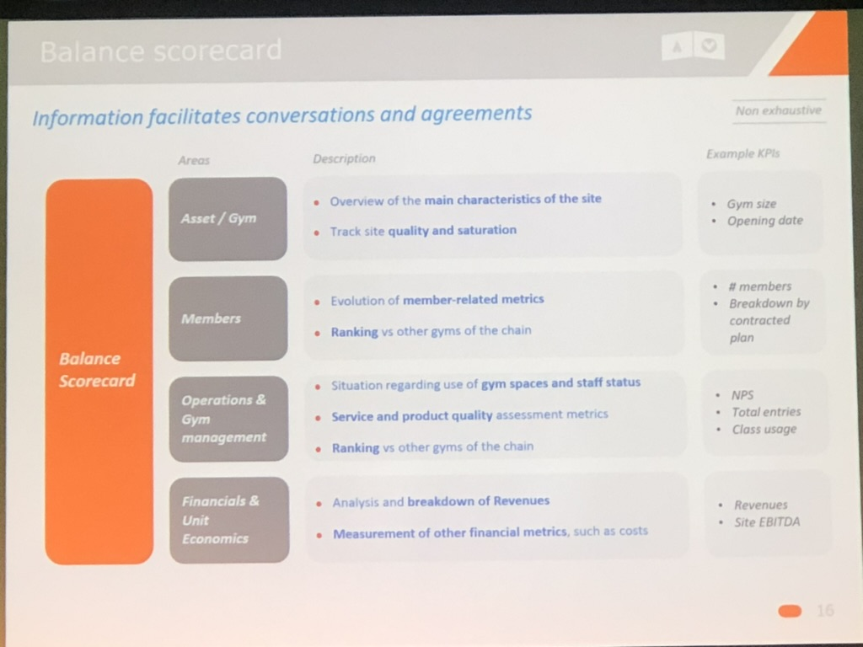
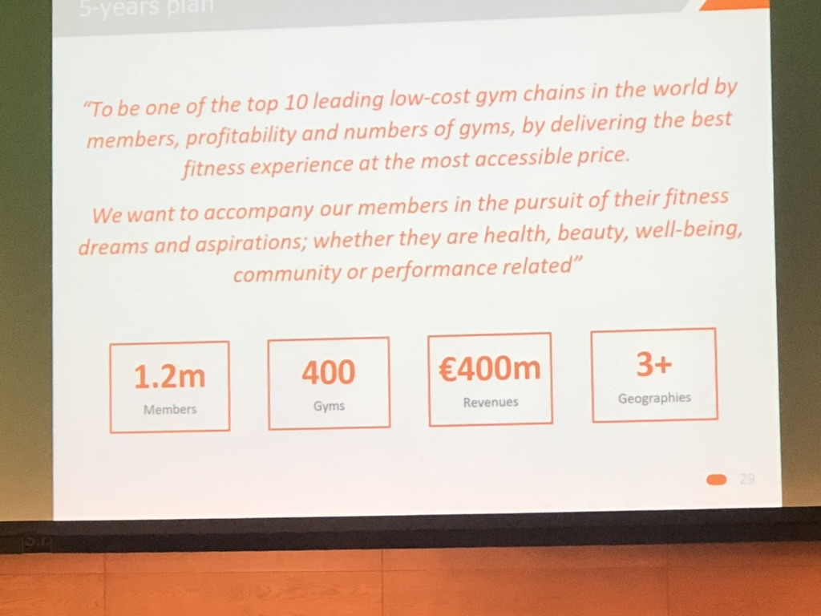
The Fitness Industry Leader of 2023 – Juan del Rio Nieto, Viva Gym Group

Slide 12
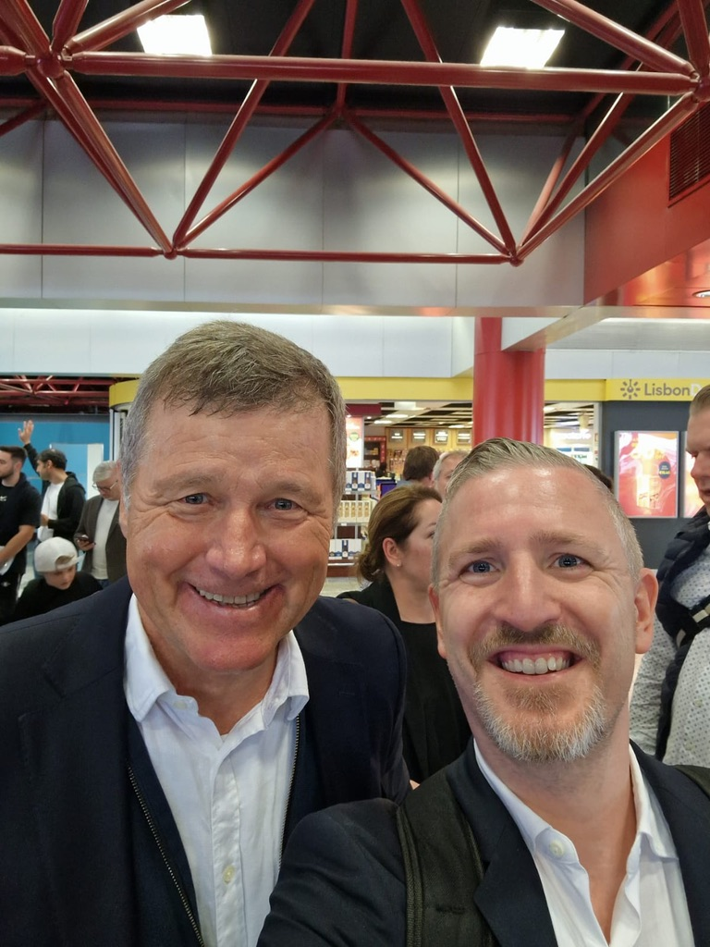
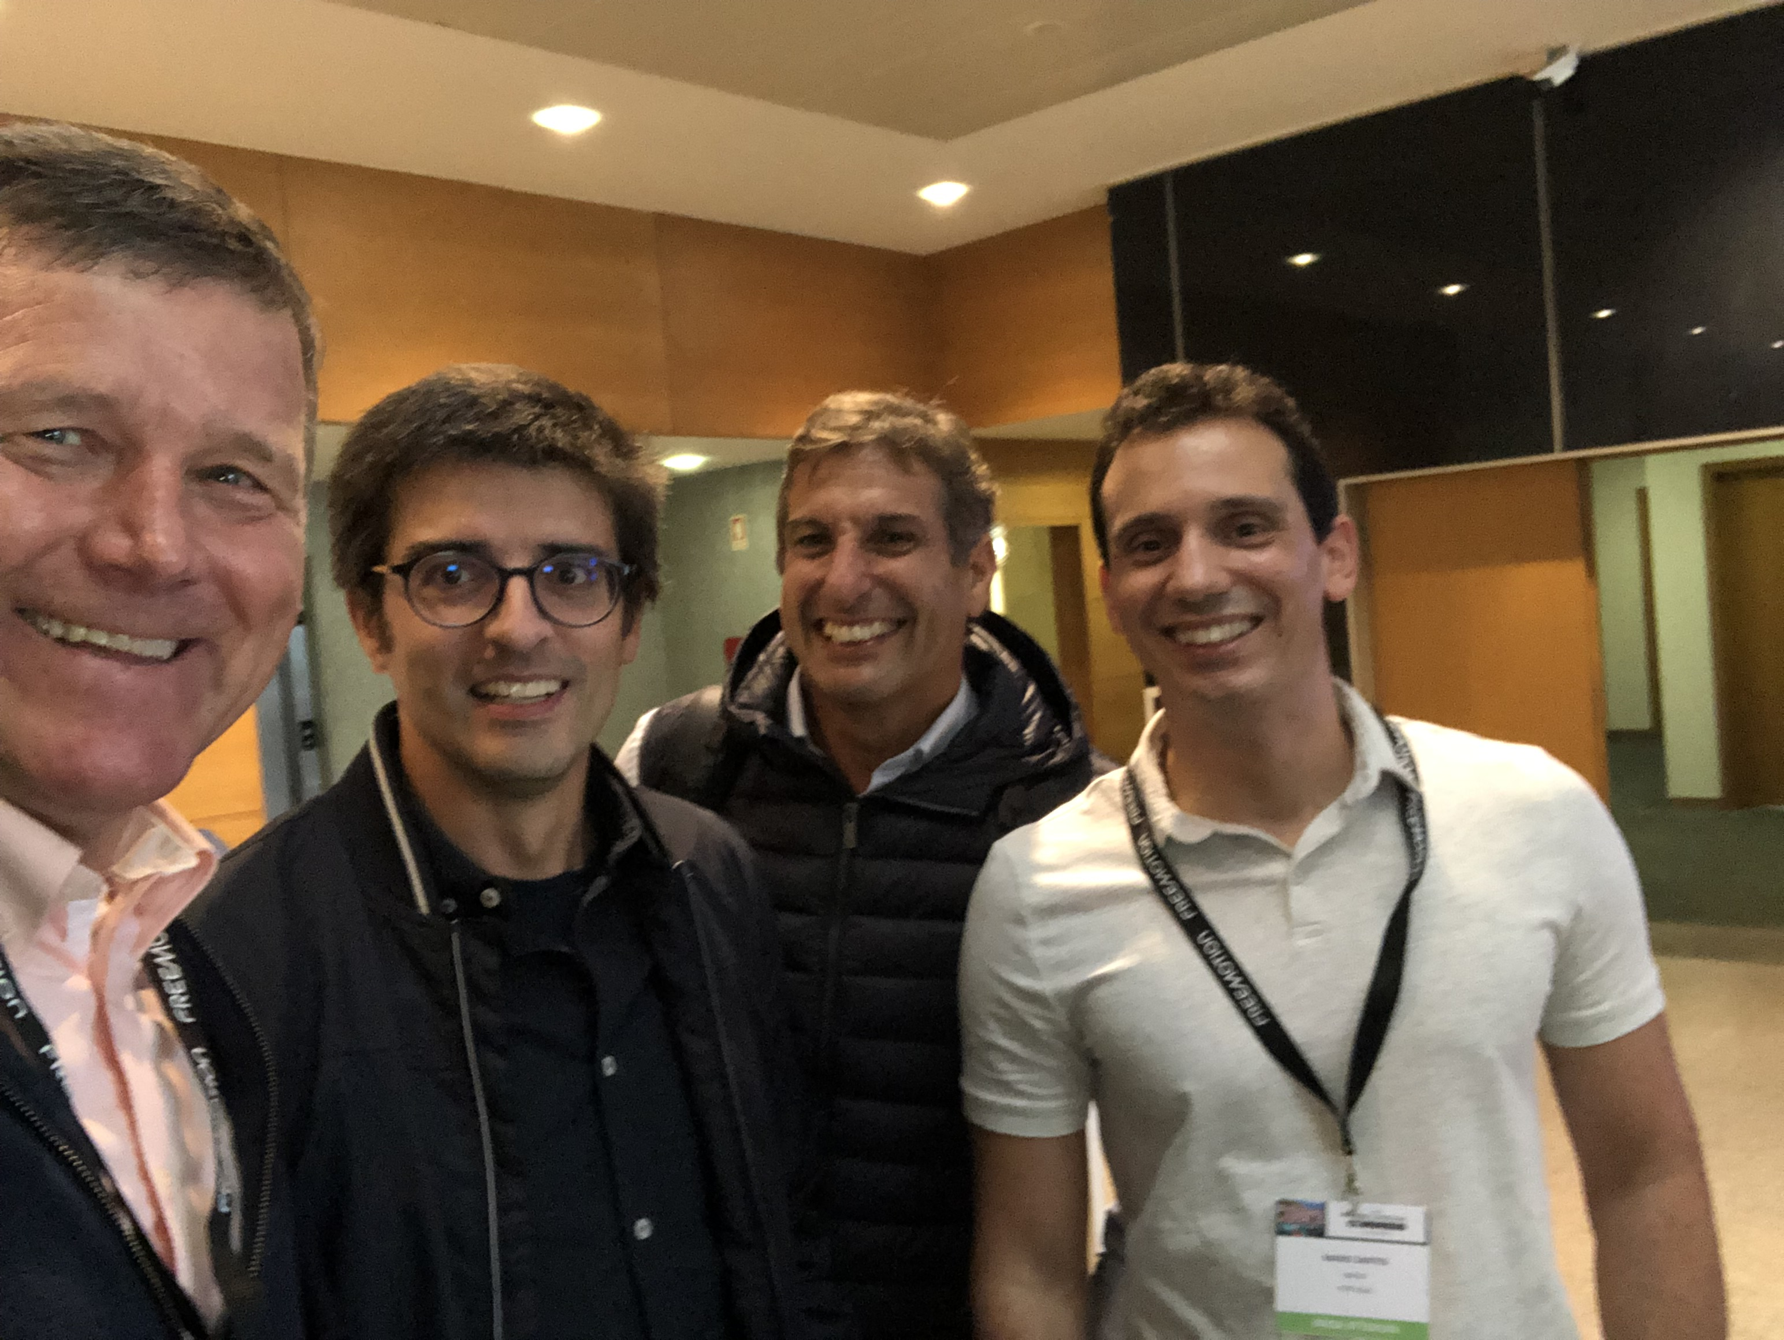
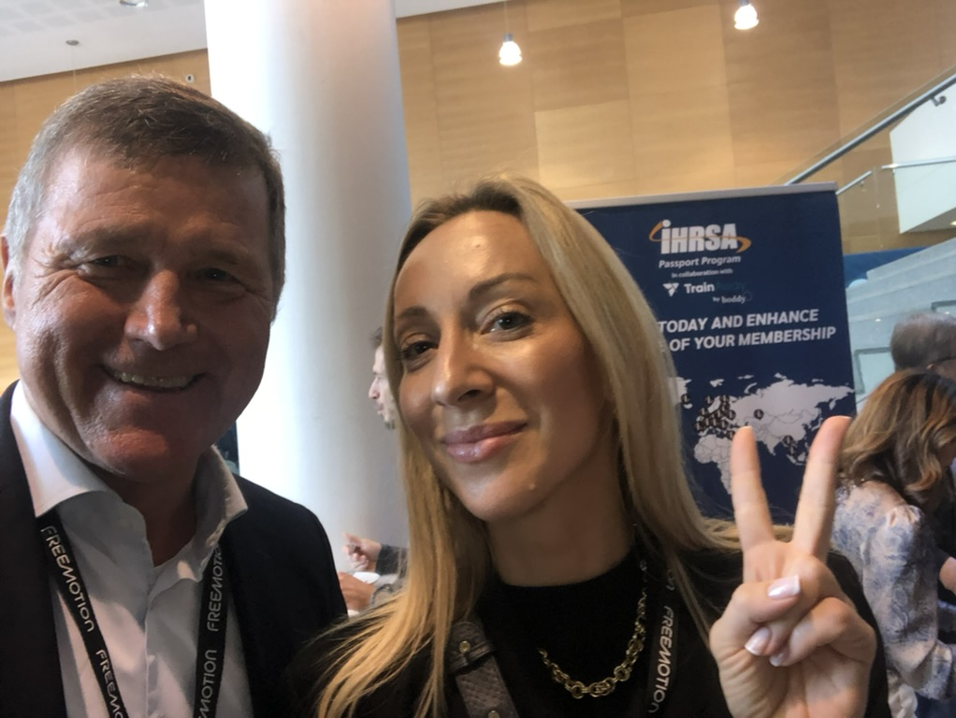
Sponsor Showcase and Networking

Slide 13
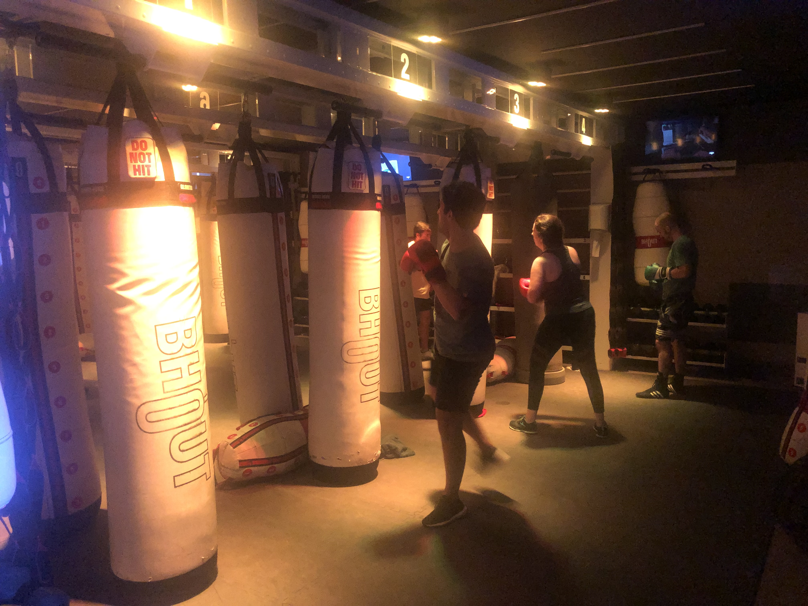
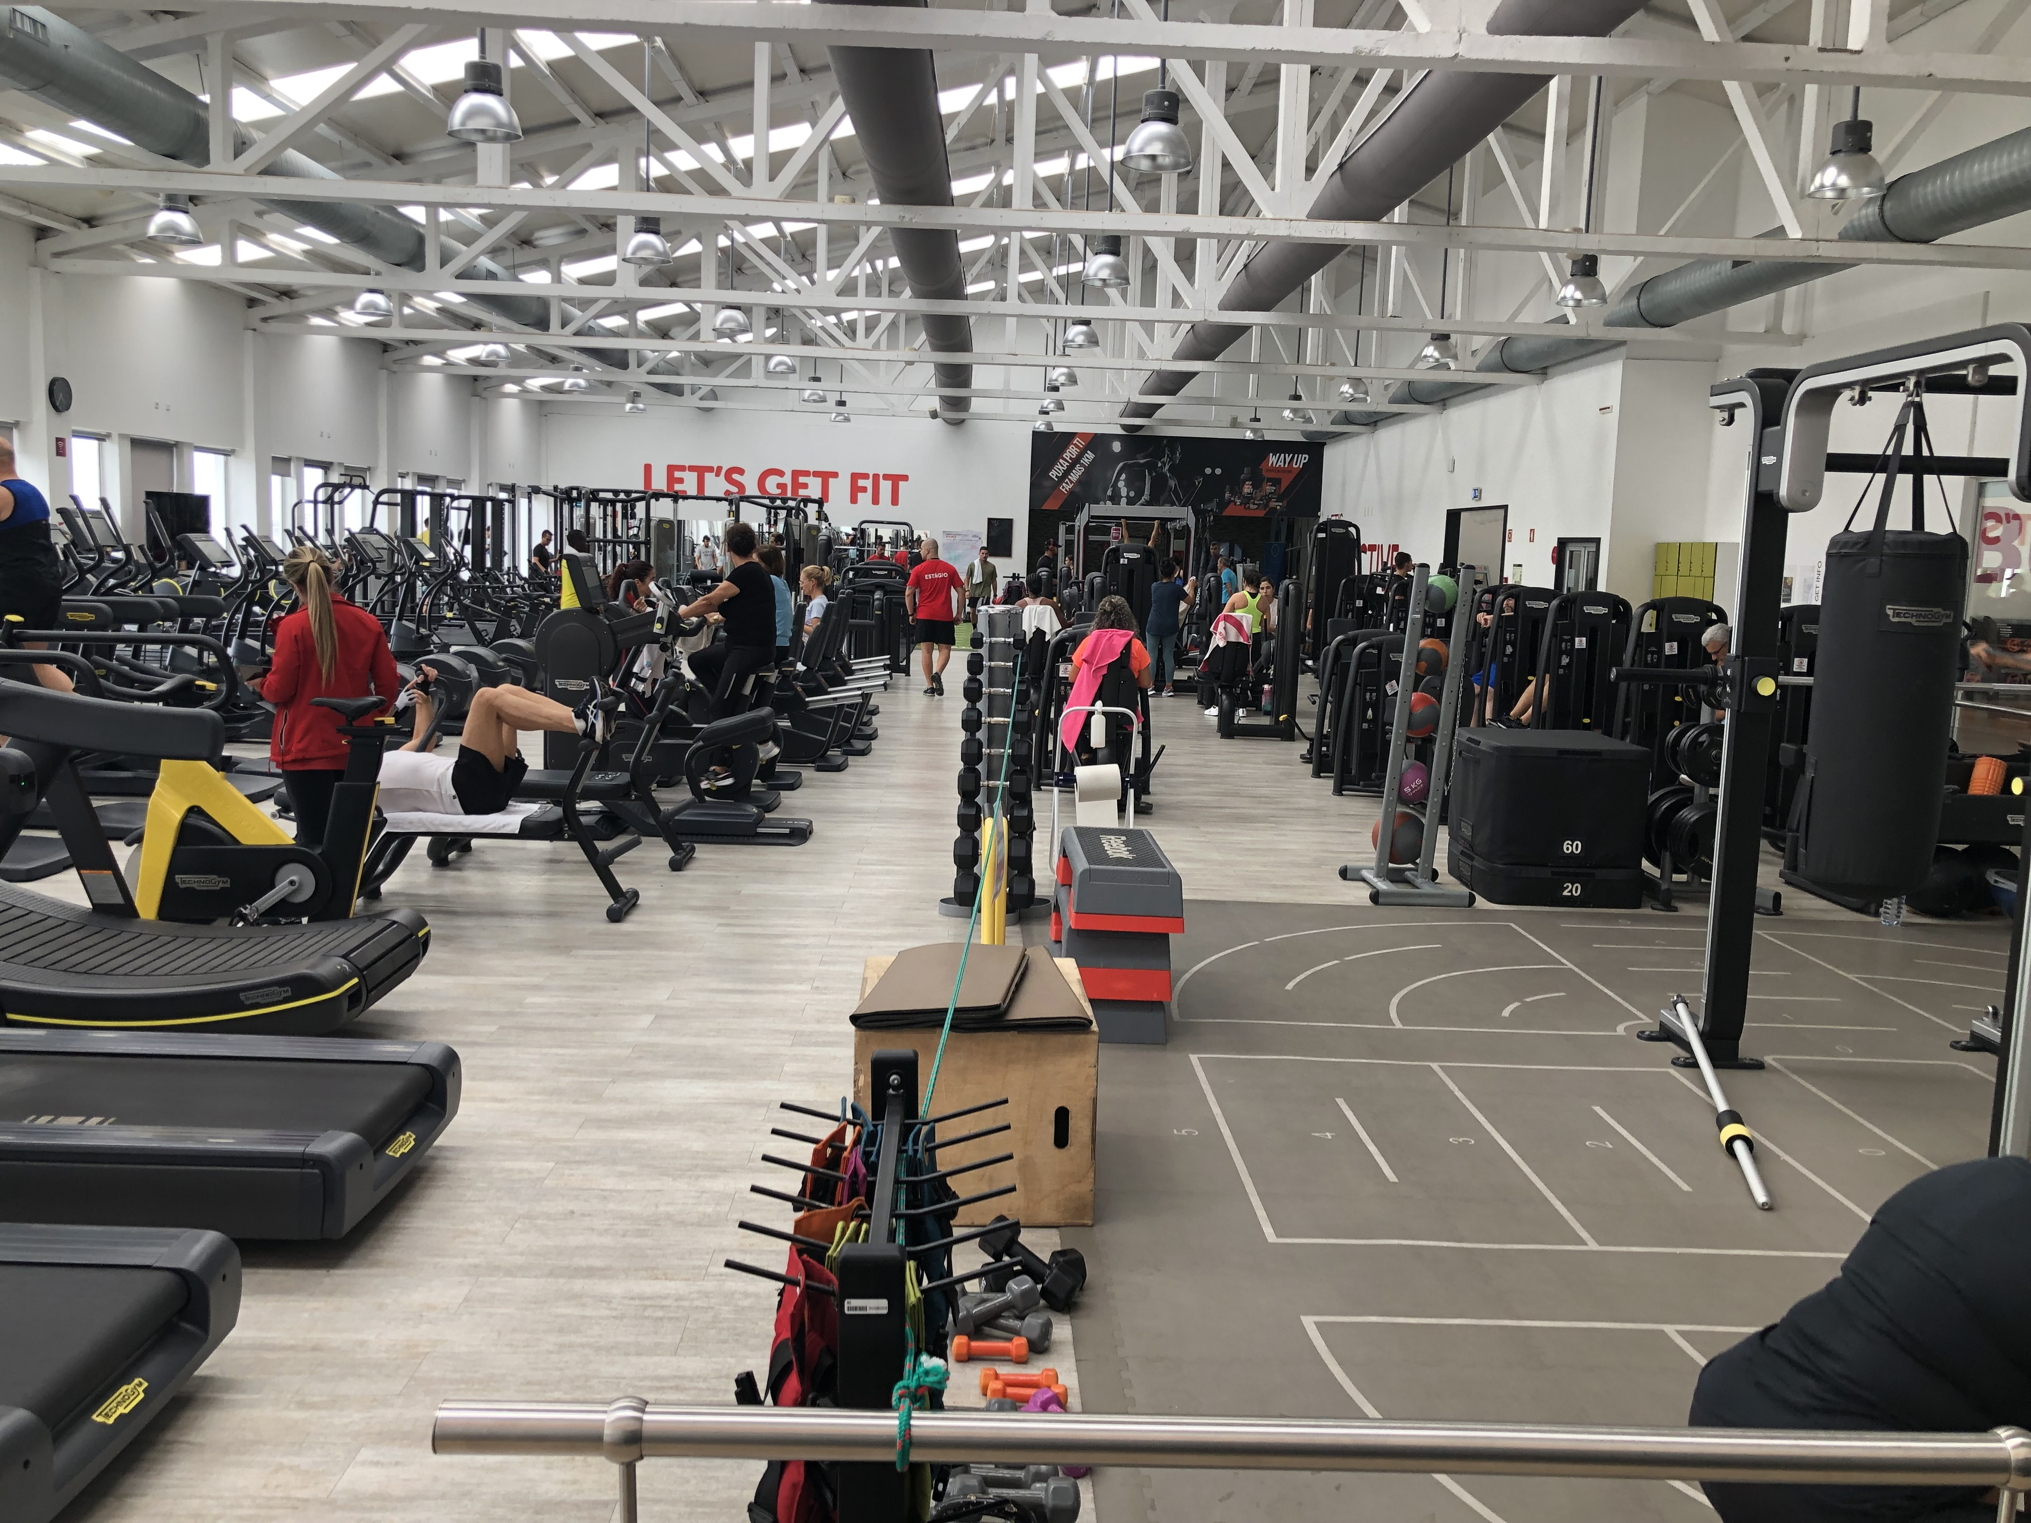
Club Tours: Solinca, Bhout and more

